Slide 1
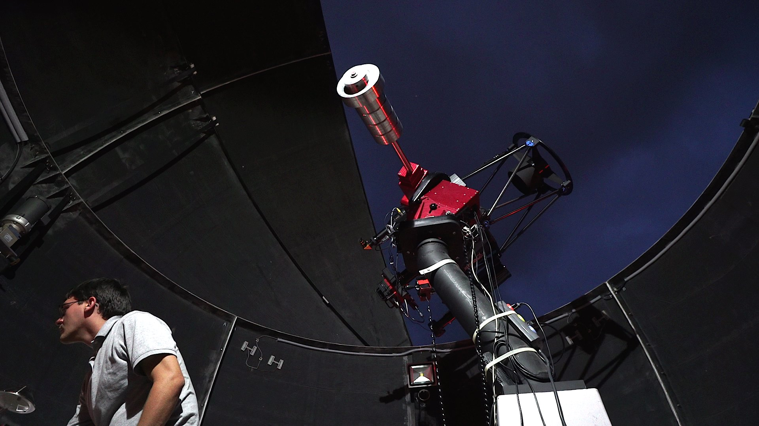
Final Project

Slide 2
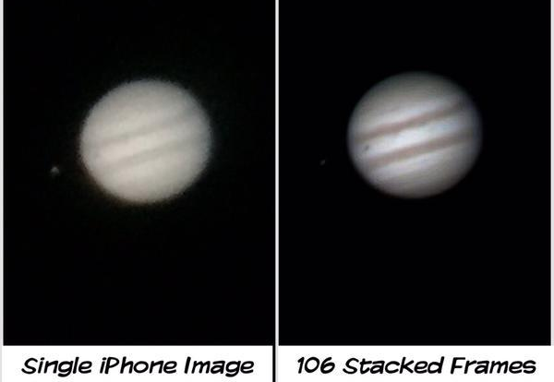
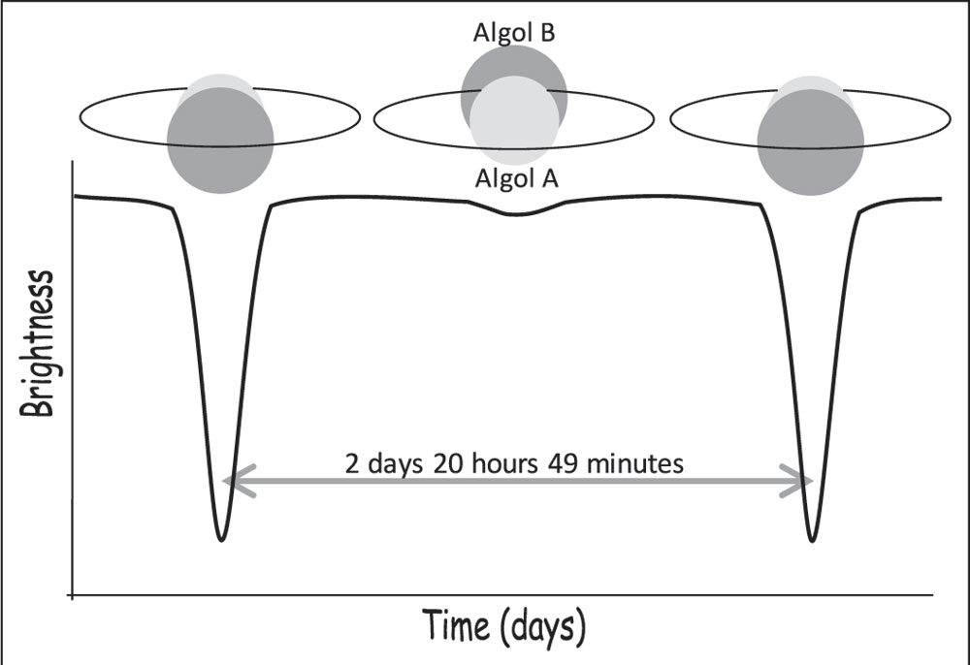
Final Project
Goal
Analyze a set of images
Write a scientific paper
Participate in peer review
Present your results
Projects
Stacked, tri-color Image
Animation of asteroid
Light curve of Variable star / Exoplanet

Slide 3
Possible Projects
Type | Objects | Data Product | Data Analysis | Max Groups
Galaxy | M74, M77 M81, M82 | Stack Filters Tri-Color Image | Size | 1
Nebula | Crab, Helix Dumbbell Little Dumbbell NGC 604 | Stack Filters Tri-Color Image | Size | 1
Star Cluster | M13 M15 | Stack Filters Tri-Color Image | Size | 1
Asteroid | 45 Eugenia | Animation | Speed
Exoplanet | XO-1 | Light Curve | Size of exoplanet
Variable Star | BU Vulpeculae XZ Andromedae | Light Curve | Brightness Change

Slide 4
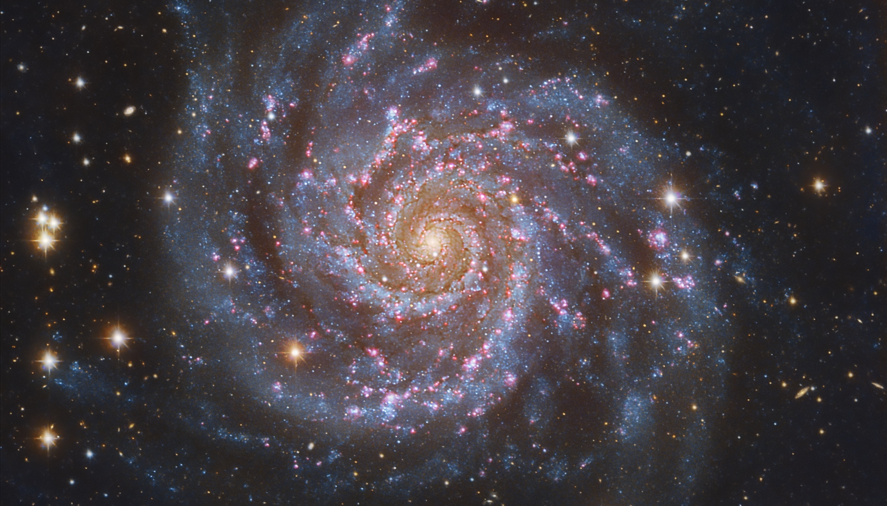
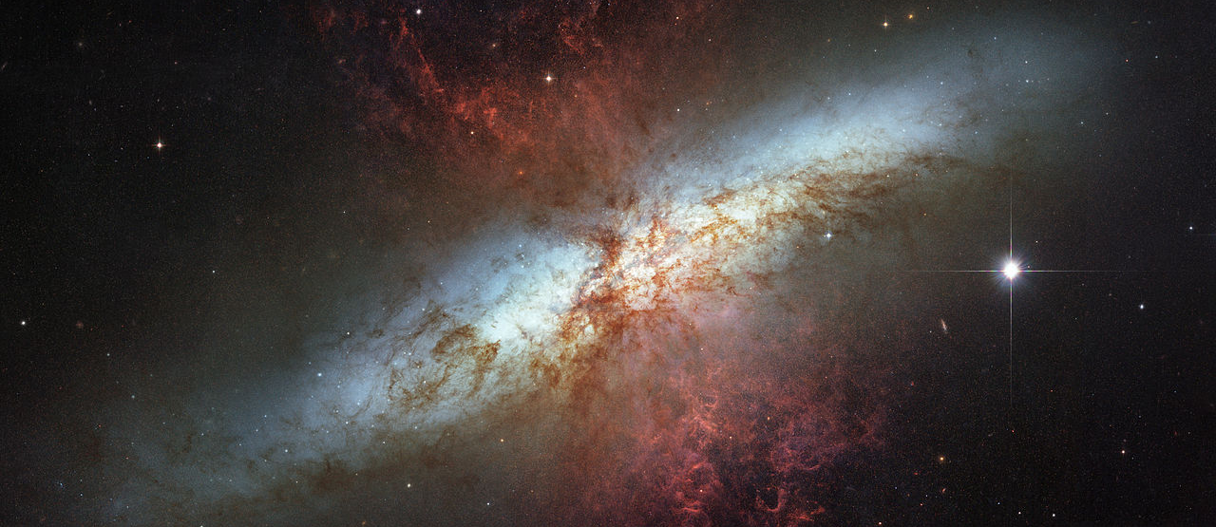
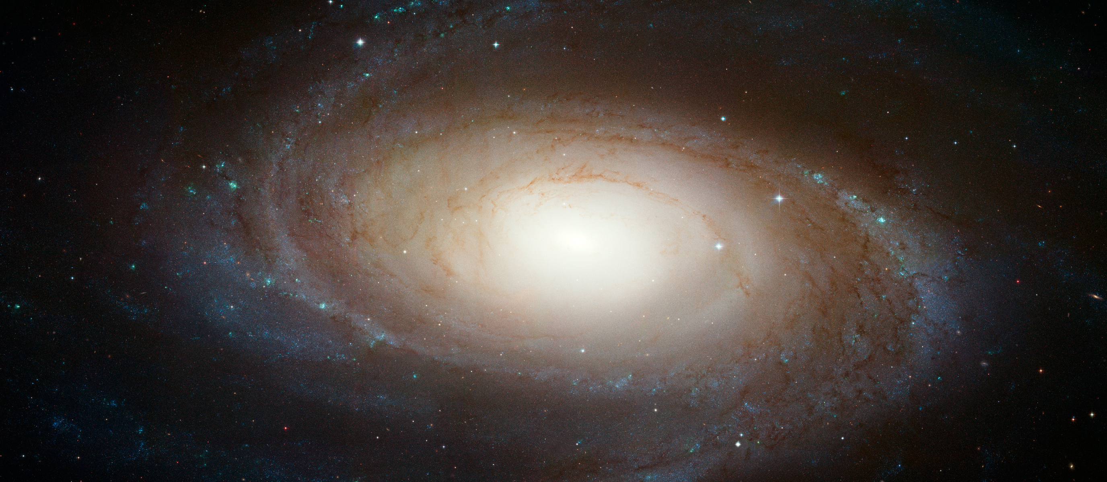
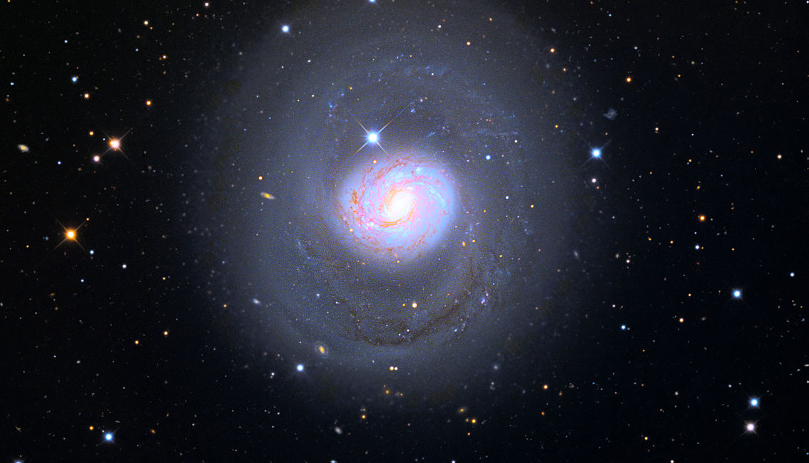

Slide 5
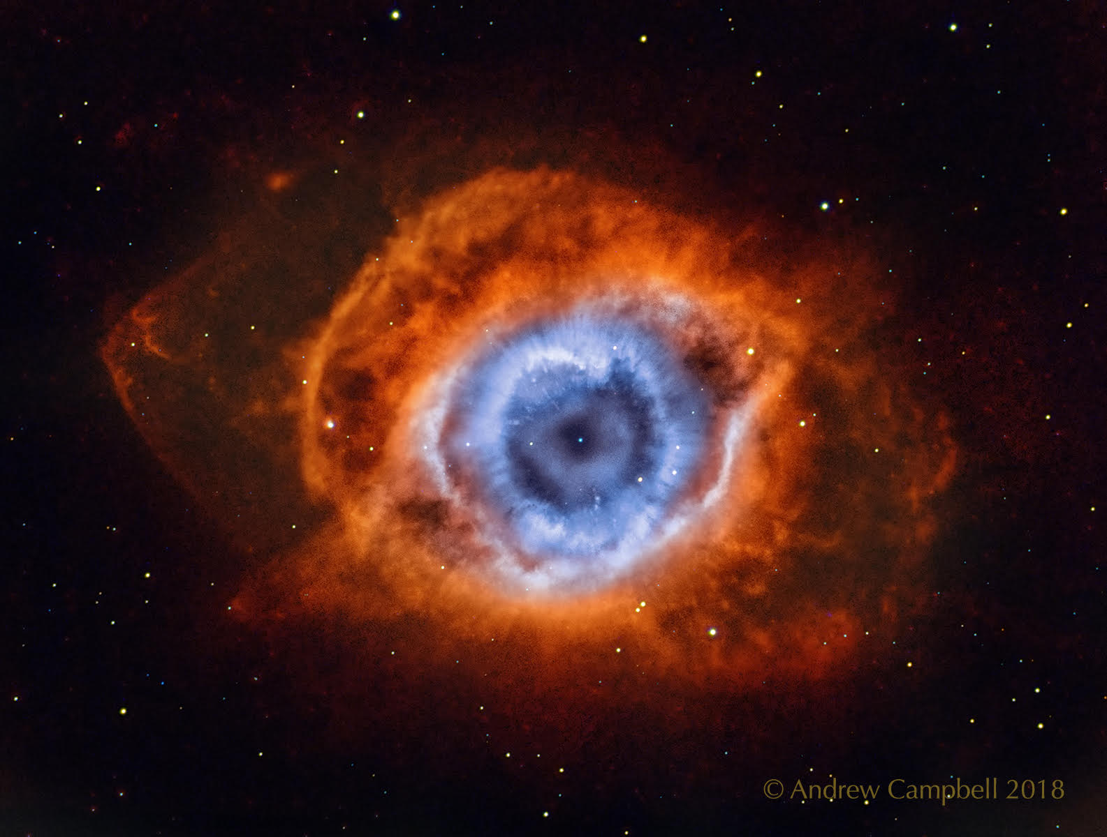
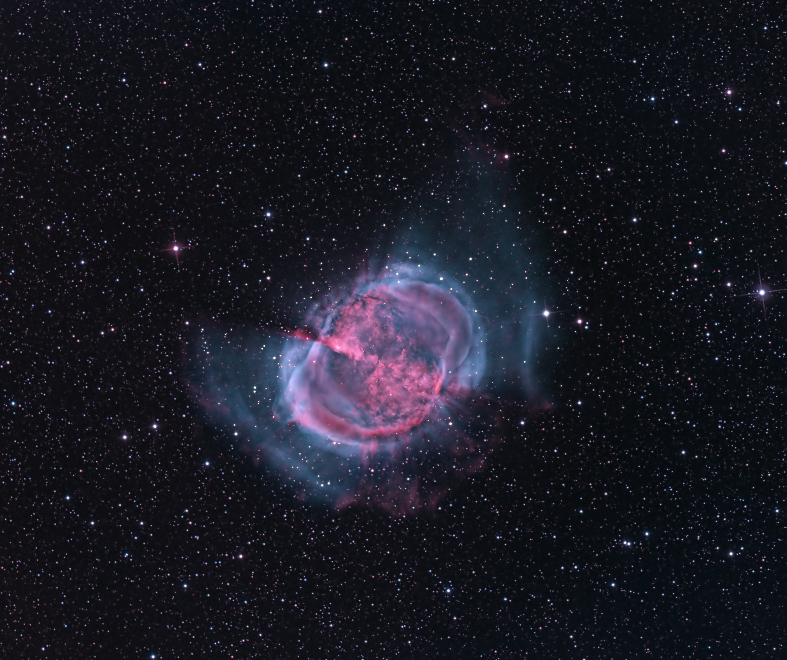
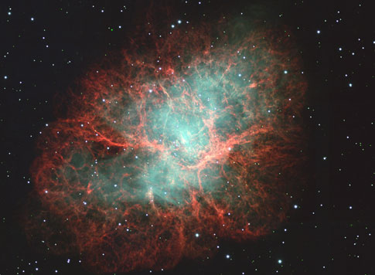
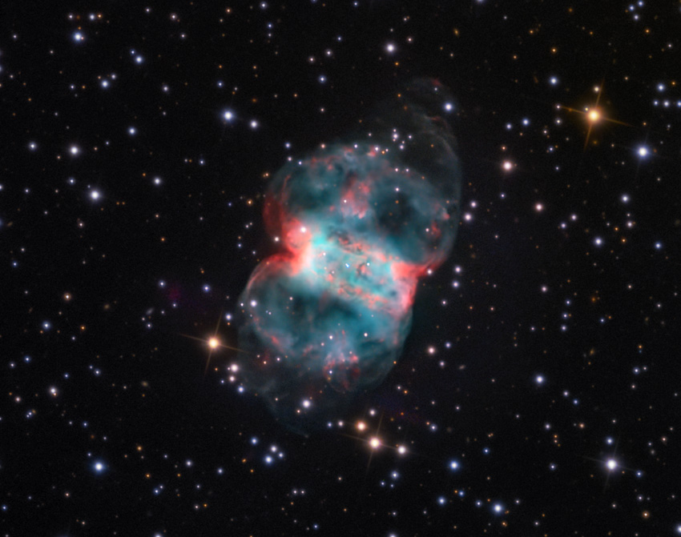
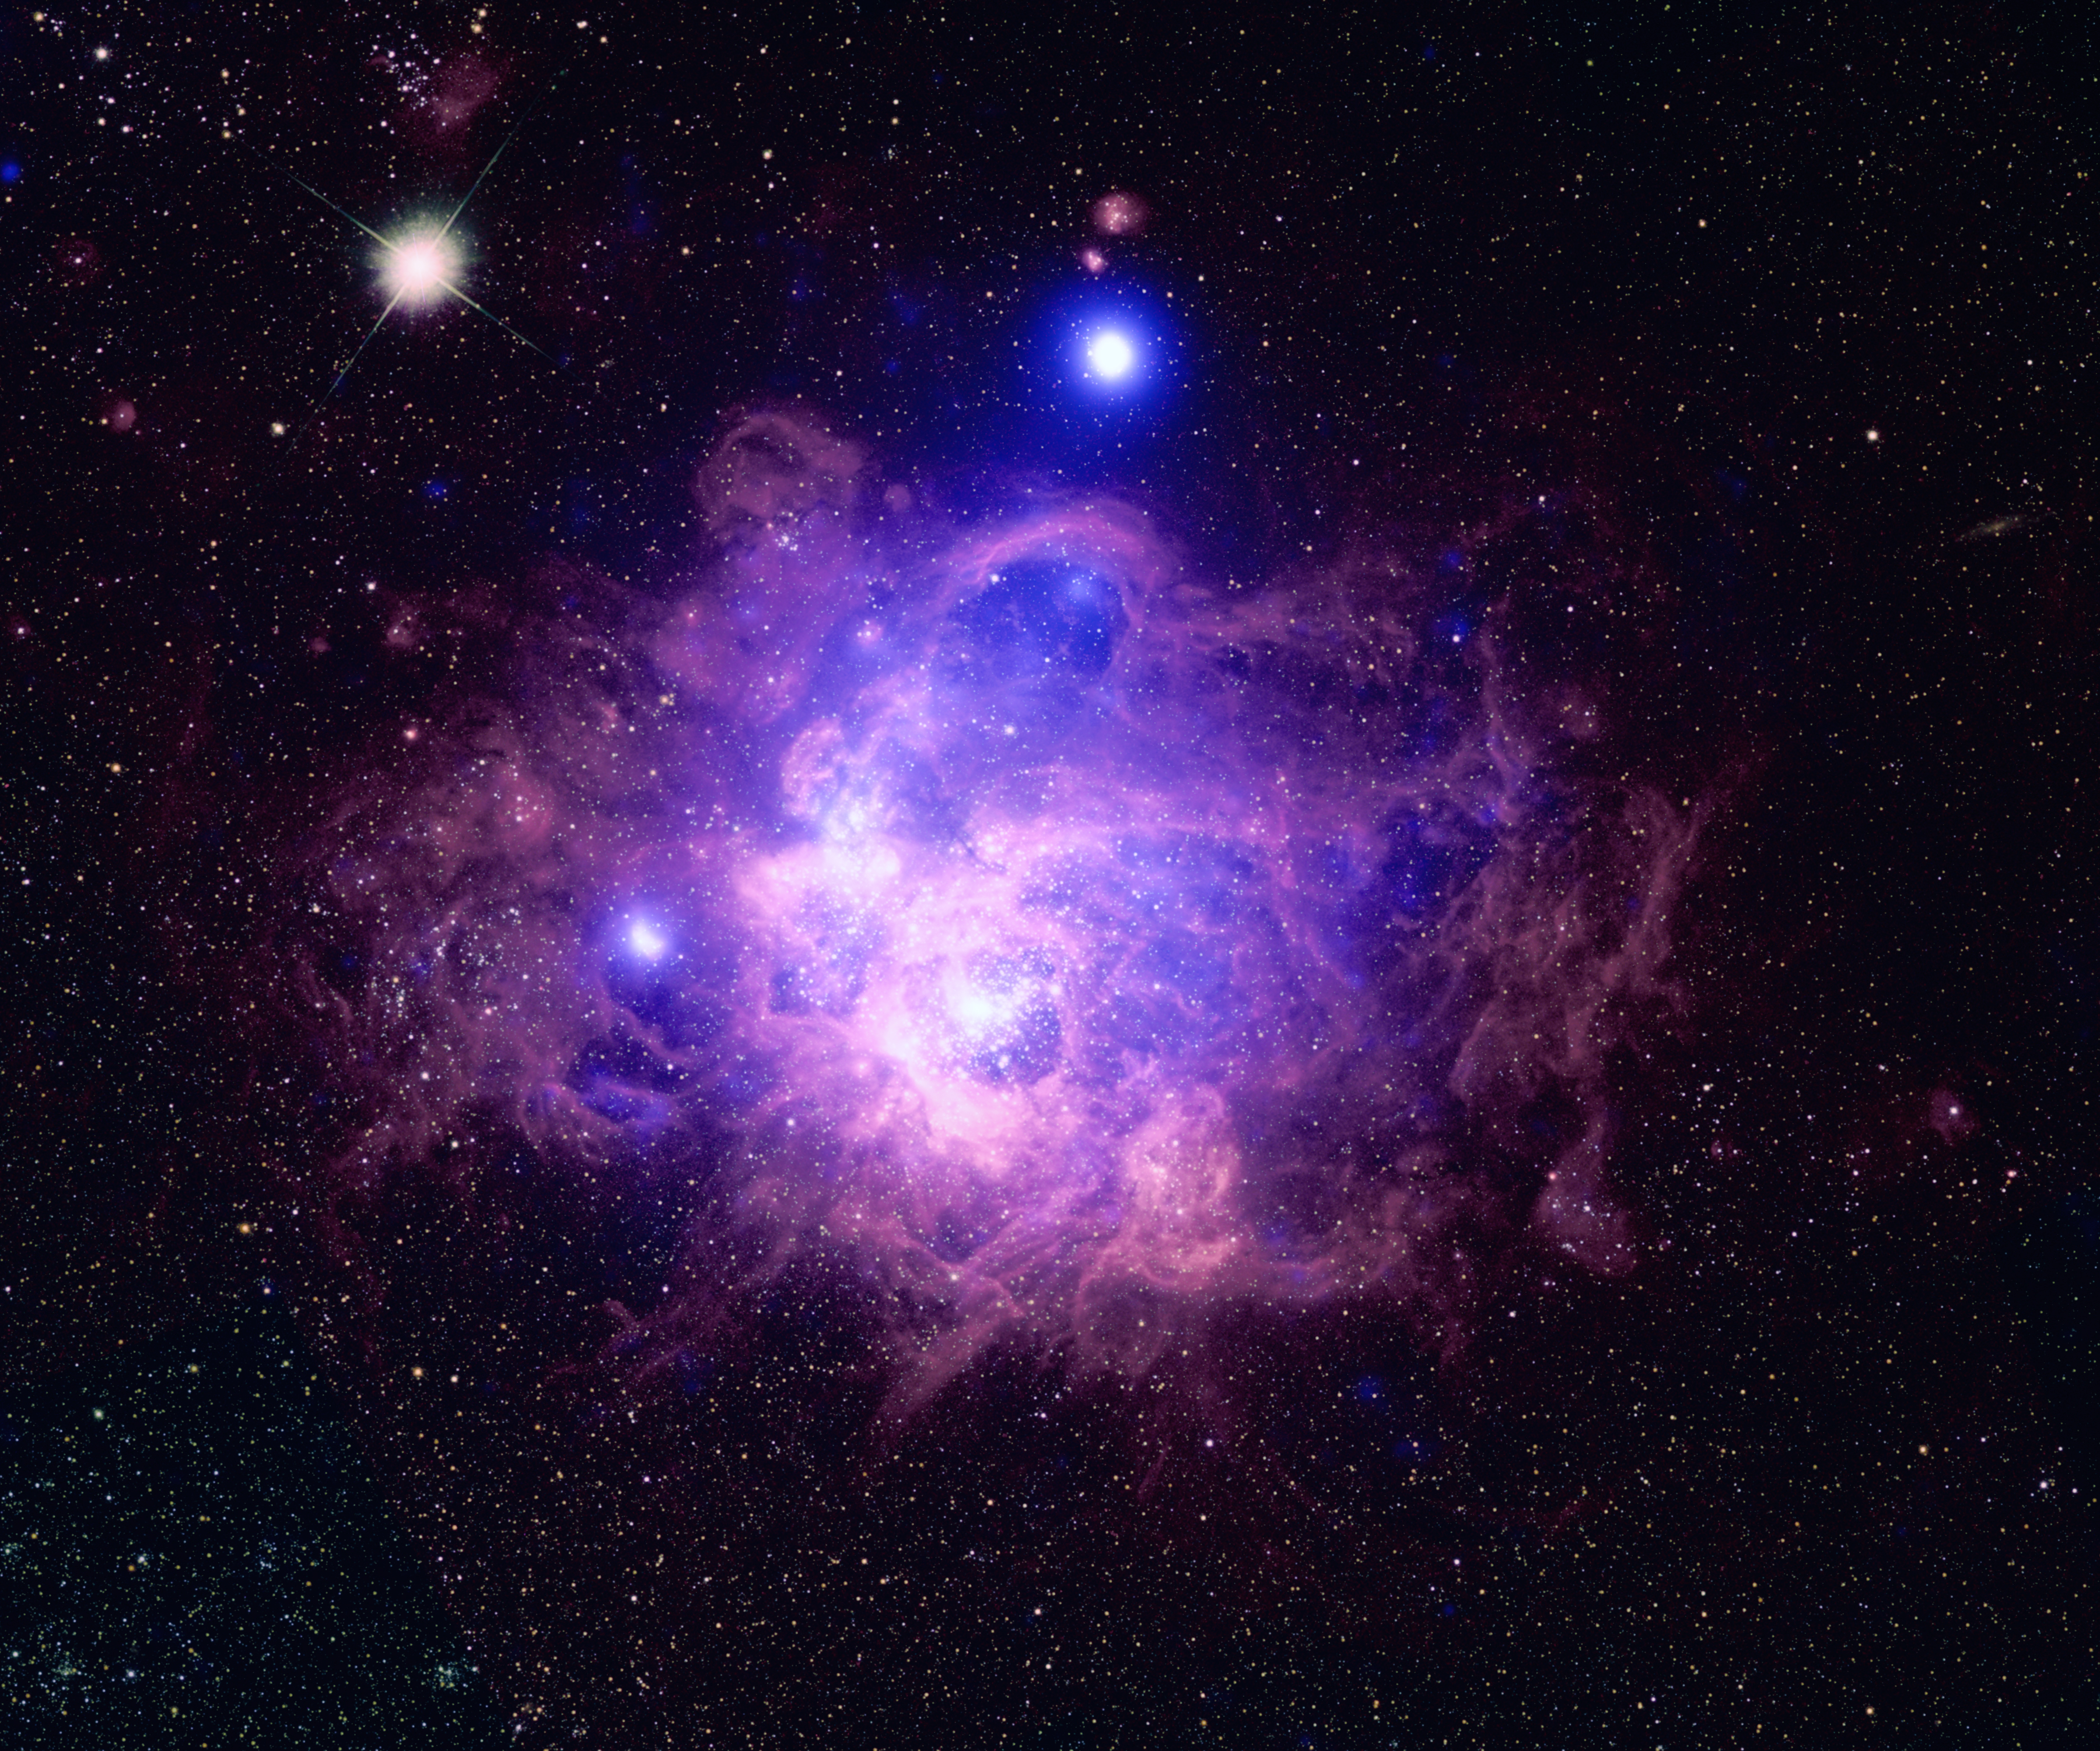

Slide 6
Project Outline
Project Paper (50 pts)
Draft + Final Version
Peer Review (20 pts)
Provide feedback to another group (ICON)
Presentation (30 pts)
Last week of lab (Dec 9)

Slide 7
Project Paper
Requirements
Group paper
Draft (~Nov 25 ?)
Peer review (early December ?)
Final draft (week of Dec 9)
Overleaf
Online collaboration
LaTeX
Background
What are you looking at?
Tell a story
Data Product
Describe how you created your data product (e.g. light curve, color image).
Focus on concepts
Why did you stack / align the stars?
Data Analysis
Describe your calculation
Let me know if someone isn't contributing!​
Notes:
Background
What object are you looking at?
Tell an interesting story about it
Experimental Plan
Describe what you did
Why stack / align stars?
Include Picture
Calculation
Show you work, explain variables

Slide 8
Project Presentation
Goal
Present the results of your analysis
Requirements
Last lab
Group presentation
6 – 8 minutes
Q&A at the end
Outline
Background
Data Product
Basic details, not recipe
e.g. stacked images, aligned stars
Not "click this button then that button"
Include figure / plot / animation
Data Analysis
May use white board
References
Notes:
Describe what you did to create your data product
Basic details, not recipe
e.g. stacked images, aligned stars
Not “click this button then that button”

